Slide 1



EMT Simu-Save
"Building realistic scenarios to increase confidence and decision-making skills for Emergency Medical Technicians”
Phase 2: Information Architecture, Wireframing & User Flow Diagram
CODEBLUE COLLECTIVE
Meghan Lawrence, Sophia Worsham, Daniel Hall

Slide 2
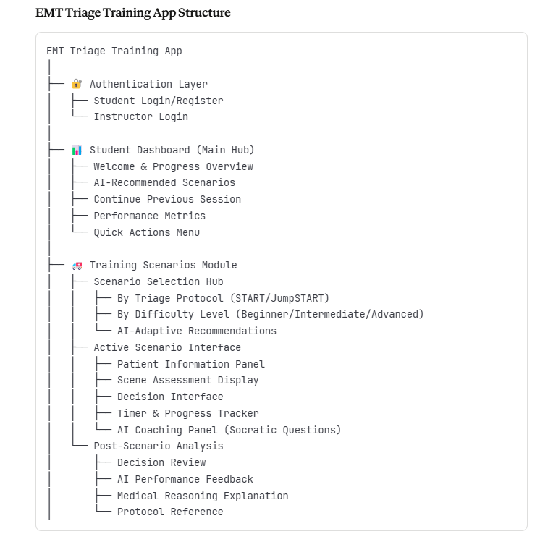

Slide 3
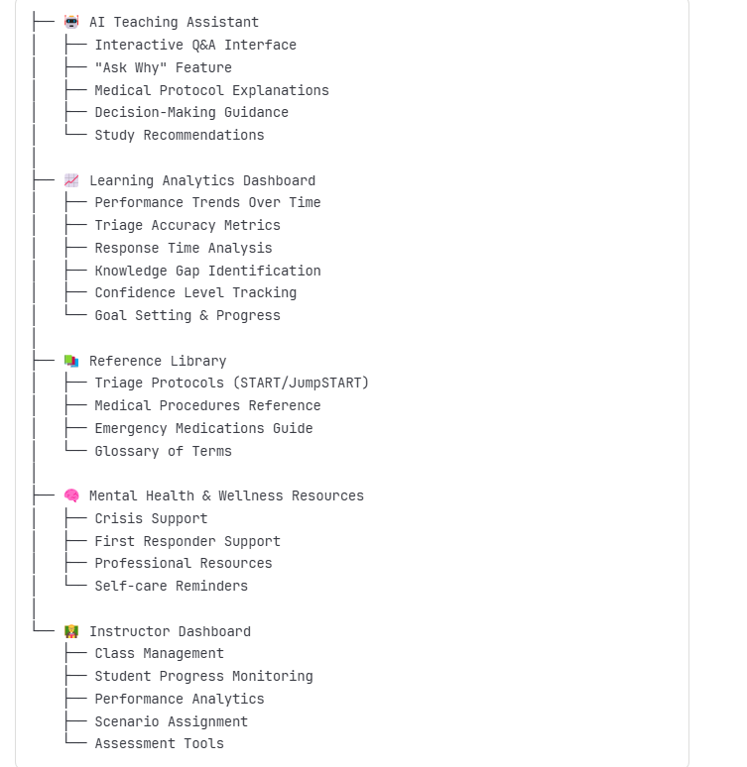

Slide 4
Content Strategy & Information Hierarchy
Dashboard Content Priority:
Immediate Actions (Continue/Start scenarios)
Progress Indicators (Visual progress bars)
AI Recommendations ("You should practice...")
Performance Insights (Areas needing improvement)
Scenario Content Hierarchy:
Critical Patient Info (Vitals, injuries - most prominent)
Scene Context (Number of patients, resources)
Action Buttons (Treatment decisions - large, accessible)
AI Coaching (Guiding questions - supportive)
Reference Access (Protocol lookup - easily accessible)
Design Philosophy: Progressive Disclosure:
Present information in layers to avoid overwhelming users during high-stress emergency scenarios.
Critical decisions are prioritized, with supporting information readily accessible but not intrusive.

Slide 5
AI Integration Points
BioBERT Medical Analysis Engine
Location: Active Scenario Interface, Post-Scenario Analysis
Function: Analyzes medical accuracy of student responses against EMT protocols
Trust Factor: Citations to specific EMT protocols
2. DialoGPT Socratic Teaching Engine
Location: AI Coaching Panel, Interactive Q&A
Function: Generates conversational teaching responses using Socratic method
Benefit: Builds confidence through guided discovery
3. Sentence Transformers Response Assessment
Location: Behind-the-scenes quality control
Function: Evaluates the quality of AI-generated responses before delivery
Reliability: Ensures consistent educational quality
4. GPT-4 Fallback System
Location: Complex scenario handling, edge cases
Function: Handles scenarios when other models struggle (quality < 70%)
Optimization: Only activated for ~10% of interactions

Slide 6
Primary Data Flow- AI-Enhanced Learning Loop
Student Input (Decision)
Decision Analysis Engine
Performance Pattern Recognition
Socratic Question Generation
Student Response & Reasoning
Understanding Assessment
Personalized Feedback Delivery
Learning Analytics Update
Adaptive Scenario Recommendation

Slide 7
AI Processing Flow (Socratic Teaching Method):
Student Makes Decision
AI Analyzes: Correct/Incorrect + Reasoning Quality
Follow-up Responses:
Reinforce
Guide
Provide Context
Connect Protocols
Confirmation of Learning
Continue or Advance Scenario
AI Evaluates Understanding Level
Student Provides Reasoning
AI Response Selection:
If Correct: "What made you choose that approach?"
If Incorrect: "What factors are you considering?"
If Hesitant: "Talk me through your thinking process"
If Pattern Error: "I notice you often... Let's explore why

Slide 8
User Flow 1: Building Confidence for “Anxious Becca”:
[Start] Becca opens app during study break
Dashboard shows: "Your confidence is growing! Ready for a new challenge?"
Becca selects "Continue Building Confidence" (AI-recommended easier scenario)
BioBERT analyzes Becca's historical weak areas → generates supportive scenario
[Loading State: "Creating a scenario to build your confidence..."]
Scenario: Single patient with clear vital signs (less overwhelming)
Becca hesitates, takes 45 seconds to decide on "Delayed" triage
DialoGPT detects hesitation pattern, generates supportive response:
"I can see you're taking time to think this through - that's actually excellent medical practice. What specific signs made you lean toward delayed?"
Becca explains: "Pulse is elevated but she's conscious and talking"
AI Coach: "That's solid reasoning! Consciousness is a key indicator. You're developing good instincts. What does our protocol say about elevated pulse?"
Becca gains confidence, references protocol correctly
Scenario continues with positive reinforcement
[End with confidence-building summary]: "You made thoughtful, protocol-based decisions. Your reasoning skills are developing well!"
Analytics show confidence improvement, next scenario recommended

Slide 9
User Flow 2: Professional Development for “Career Focused James”:
[Start] James opens app after a challenging ambulance call
AI suggests: "Want to practice scenarios similar to today's challenges?"
James selects "Advanced Multi-Trauma Practice“
Scenario: Mass casualty incident, 6 patients, limited resources
AI Coach: "Walk me through your priority rationale for these critical patients."
[GPT-4 Fallback Triggered] - Advanced response with protocol citations
Performance logged for professional development tracking

Slide 10
Instructor Scenario Assignment for "Experienced Emma“:
[Start] Emma logs into instructor dashboard.
Reviews class performance analytics showing weak areas in pediatric triage
Selects “Assign Custom Scenarios” for targeted practice
AI suggest: “Based on class data, assign pediatric emergency scenarios?”
Emma customizes scenario parameters (difficulty, patient count, time pressure)
AI generated scenario bank with protocol citations and learning objectives
Emma reviews and approves scenarios for assignments
Students receive targeted practice assignments with Emma’s feedback enabled
Real-time progress monitoring shows student improvement in weak areas

Slide 11
User Flow 4 - Reference Library & Self-Directed Learning:
[Start] Student encounters unfamiliar medication during a scenario
AI-powered search: Student types “epinephrine pediatric dosing”
System returns relevant protocol sections with visual aids
Student review information with Ai highlighting key points
AI asks: “Ready to return to your scenario with this knowledge?”
Student resumes scenario with new understanding
AI tracks knowledge gap closure for future recommendations
Pauses scenario, selects” Reference Library”

Slide 12
User Flow 5 - AI Suggestion Modification & User Control
[Start] AI recommends “Advanced Trauma Scenarios” based on performance
User Control Panel appears with options:
-Adjust difficulty level
-Change scenario type
-Set time preferences
-Request confidence-building focus
AI acknowledges: “I’ve updated your recommendation, Building confidence first is smart.”
Modified scenario generated matching student preference
System learn from user feedback for future recommendations
Student feels overwhelmed, selects “Modify Recommendations”
Student adjusts to “Intermediate Single-Patient scenarios”

Slide 13
Edge Case Scenarios Planning & Error Handling
AI System Failures
  Student starts scenario
  → AI coaching service unavailable
  → [Fallback]: Display basic feedback mode
  → Show correct answers with protocol references
  → "AI coaching will return shortly. Continue with basic practice?"
Student Frustration/Confusion
Student makes repeated incorrect decisions
→ AI detects frustration pattern
→ [Intervention]: "This seems challenging. Would you like to:“
Review the protocol first
Try an easier scenario
Get a hint
Take a break
Overconfident Student Pattern:
  Student consistently chooses quickly and correctly
  → AI detects an overconfidence pattern
  → Introduce more complex scenarios
  → Add time pressure or complications
  → Guide the student to recognize complexity
  → Build humility and a deeper understanding

Slide 14
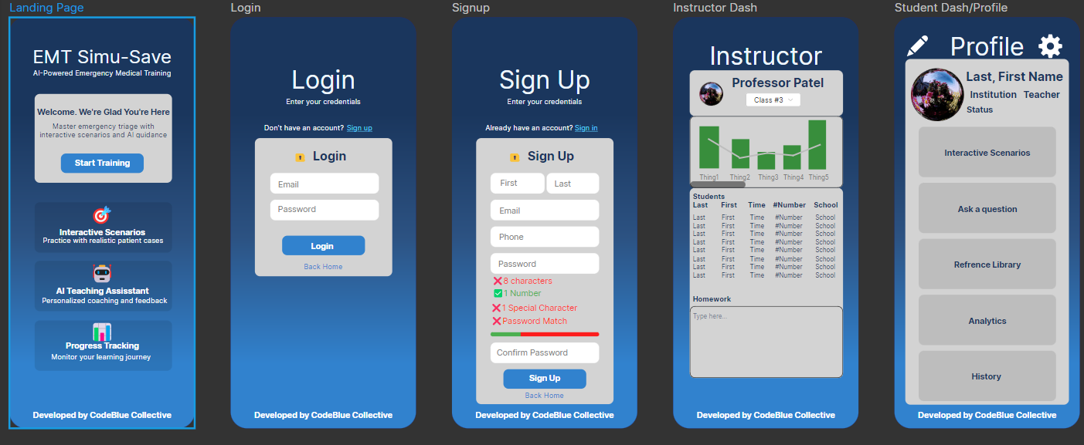
Mockup Photos

Slide 15
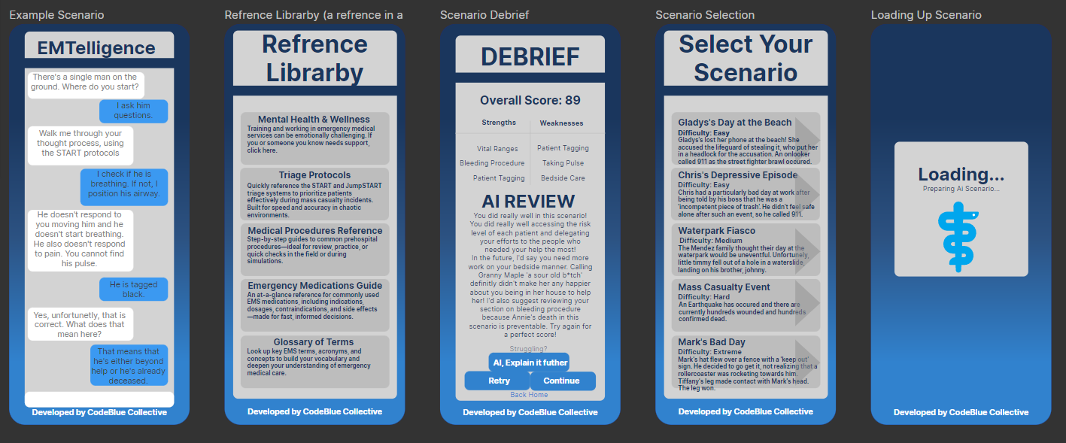
Mockup Photos

Slide 17
AI Integration Principles:
Transparency: Always indicate when AI is providing guidance
Medical Accuracy: All AI responses cite EMT protocols
Progressive Disclosure: Don't overwhelm with information
Graceful Degradation: Work offline when AI is unavailable
Accessibility Features:
Large buttons (44px min) for use with gloves
High contrast colors for visibility in poor lighting
Screen reader compatibility for visual impairments
Voice interaction option for hands-free operation
Adjustable text size for different visual needs

